Slide 1
Welcome to !
NLP
(Natural language Processing)

Slide 2
Natural Languages:
  Natural language means a human language. For example, English, Urdu, French, and Chinese are natural languages.
  Three basic entities: letters, words and sentences.
  Groups of letters make up words and groups of words make up sentences and so on.

Slide 3
Applications of AI
  Game playing
  General problem solving
  Expert system
  Natural language Processing
  Computer vision
  Robotics
  Education
  Others

Slide 4
What is NLP?
NLP is a field of computer science, AI concerned with the interaction between computer and human (natural) language.
NLP is the ability of a computer program to understand human language as it is spoken.
Example: Google
NLP is a component of AI.

Slide 5
What is NLP?
The field of NLP involves making computers to perform useful tasks with the natural languages humans use. The input and output of an NLP system can be −
Speech
Written Text

Slide 6
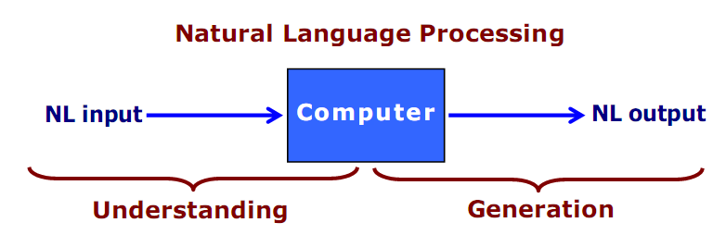
What is NLP?
Getting computers to understand and communicate in everyday language is known as natural language processing.

Slide 7
Components of NLP
There are two components of NLP
Natural language understanding (NLU)
How computer understand
Natural language generation (NLG)
How they reply to you

Slide 8
Natural Language Understanding
Natural-language-understanding systems convert samples of natural human language into more formal representations that are easier for computer programs to manipulate.
Here the speech or text input get then transformed into useful representation in order to analyze the various aspects of language .
Note: The NLU is harder than NLG.

Slide 9
Syntax, Semantic
NLP Terms
Syntax concerns the proper ordering of words and its affect on meaning (grammar).
Syntax is the study of the structure of sentence
  The dog bite the boy.
  The boy bite the dog.
  Bite boy dog the the.
Semantics concerns the (literal) or real meaning of words, phrases, and sentences.
Semantics is the study of meaning in language.
  “plant” as a photosynthetic organism.
  “Computer "as a photosynthetic organism.

Slide 10
Pragmatics
A pragmatic way of dealing with something is based on practical considerations, rather than theoretical ones.
A pragmatic person deals with things in a practical way.
Pragmatics is used for understanding the context and purpose of saying the words.
Concerns how sentences are used in different situations and how use affects the interpretation of the sentence.
Pragmatics is the study of how words are used.

Slide 11
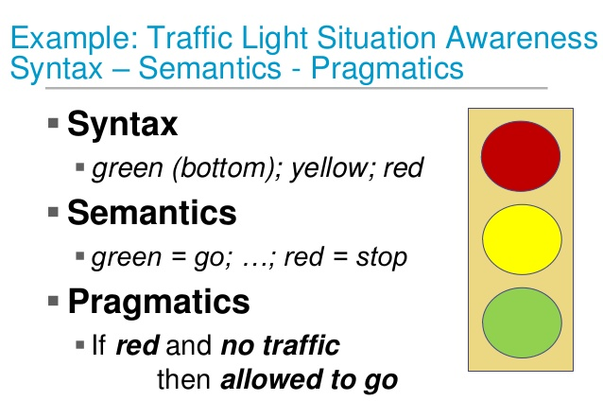

Slide 12
NLP Terms
Tokenization: The early step in NLP. It splits longer sentences to smaller parts called tokens. Passages can be tokenized to sentences and further sentences can be tokenized to words.
e.g# “ David is an Engineer”
Tokenized [“David”, “is”, “an”, Engineer”]
Stemming: Stemming is the process of eliminating postfix and prefixes. And bringing the word to its root form.
e.g# running ---- run

Slide 13
NLP Terms
Lemmatization: Lemmatization is related to stemming. But it's advantage is that it captures canonical form of words.
e.g# better------- good
Stop words: Stop words are those words who occur multiple time in a text.
e.g# the, it, an
Information Retrieval: Information retrieval is the process of extracting information from knowledge sources in response to some need.
e.g# Google Search (‘Cricket’)
Notes:
Canonical mean according to order.

Slide 14
Difficulties in NLU
NLP Can Be Ambiguous
Different meaning of same sentences
Ambiguity occurs when something is open to more than one interpretation.
Different types of Ambiguity
1) Lexical Ambiguity: It mean word level ambiguity
Lexical ambiguity is the presence of two or more possible meanings within a single word.
words have multiple meaning.
example :orange
Give me a ring
saw = past tense of "see" or (to cut with a saw.)?
bat (bat = flying mammal / wooden bat)

Slide 15
Types of Ambiguity
2) Syntactical Ambiguity: A sentence can be parsed in different ways. It is about parsing the sentence (grammatically ambiguity ).
The structural ambiguities were syntactic ambiguities.
Example: a) Every man loves a Money
The interpretations can be, For every man there is a woman and also it can be there is one particular woman who is loved by every man.
b) Look at that dog with one eye .
Am I close an eye and look at the dog or does the dog have one eye?

Slide 16
Types of Ambiguity
3) Semantic Ambiguity: This occurs when the meaning of the words themselves can be misinterpreted.
There are two ways of reading the sentence.
Consider the example, Seema loves her mother and uzma does too.
The interpretations can be uzma loves Seema’s mother or uzma likes her own mother.
Semantic ambiguities born from the fact that generally a computer is not in a position to distinguishing what is logical from what is not.

Slide 17
Consider the example:
The car hit the pole while it was moving.
The interpretations can be
The car, while moving, hit the pole
And The car hit the pole while the pole was moving. The first interpretation is preferred to the second one because we have a model of the world that helps us to distinguish what is logical (or possible) from what is not.
To supply to a computer a model of the world is not so easy.

Slide 18
Types of Ambiguity
4) Referential Ambiguity: Meaning is not well referred from the sentence.
Referential ambiguity occurs when a word or phrase, in the context of a particular sentence, could refer to two or more properties or things.
It is sometimes clear from the context which meaning is intended, but not always.
Example: Meera went to Geeta and said “ I am hungry”
Here who is hungry is not clear from the sentence.
Mary loves boy friend
This is Referential Ambiguity.

Slide 19
Knowledge for Languages Understanding
A natural language understanding system must have knowledge about what the words mean, how words combine to form sentences, how word meanings combine to from sentence meanings and so on. The different forms of knowledge required for natural language understanding are given below.
Also called levels of understanding.

Slide 20
Levels of Understanding
Phonetic is the study of combination of sounds into organized units of speech,
It is study of organizing sound systematically.
The sounds of human
speech.
How are words related to the sounds that make them?
/puh-lee-z/ = please
Important for speech recognitions systems
Phonetic

Slide 21
Levels of Understanding
Phonetic
Morphological
Morphology: Morph mean form or shape/structure.
The study of internal structure of words.
How words are construed out smaller units called morphemes.
A single words may be more morphemes.
E.g: unhappier
Un+happy+er(Here are three morphemes

Slide 22
Levels of Understanding
Phonetic
Morphological
It is a study of construction of words from primitive or initially meaningful units.
How are words constructed from more basic components
Un-friend-ly.
Gives information about function of words.

Slide 23
Levels of Understanding
Phonetic
Morphological
Syntactic
How are words combined to form correct sentences?
What role do words play?
It deals with how words can be put together to form correct sentences.
Best understood – Well studied for formal languages
E.g: Grammar

Slide 24
Levels of Understanding
Phonetic
Morphological
Syntactic
Semantic
What do words mean? How do these meanings combine in sentences?
Defining the meaning of a sentence is very difficult due to the ambiguities involved.

Slide 25
Levels of Understanding
Phonetic
Morphological
Syntactic
Semantic
Pragmatic
It concerns how sentences are used in different situations and how use affects the interpretation of the sentence.
Its is concern with practical.
Dependent on speaker intentions or purpose.

Slide 26
Levels of Understanding
Phonetic
Morphological
Syntactic
Semantic
Pragmatic
Understanding the text & dialogues.
It derives Knowledge from external common sense information.
Exp: Do you know what time it is?
It does not mean the speaker asking you the time!!!
We should understand what to do?

Slide 27
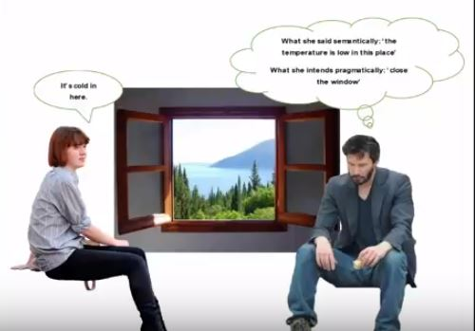
Example

Slide 28
Levels of Understanding
Phonetic
Morphological
Syntactic
Semantic
Pragmatic
Discourse level
It deals with how the immediately preceding sentence can affect the interpretation of the next sentence.
The meaning of Individual sentence is depend on previous sentence.
Example:
Bill had a red balloon.
John wanted it.

Slide 29
Levels of Understanding
Phonetic
Morphological
Syntactic
Semantic
Pragmatic
Discourse level
World knowledge
World knowledge is nothing but everyday knowledge that all speakers share about the world.
What each language user must know about the other user’s beliefs and goals.
This essential to make the language understanding much better.

Slide 30
Natural Languages vs. Formal Languages
Ambiguity is the primary difference between natural and Formal languages (Programming languages).
Formal programming languages are designed to be unambiguous, i.e. they can be defined by a grammar that produces a unique parse for each sentence in the language.
Parse: To separate a sentence in to grammatically parts such as verb,adverb.e.t.c

Slide 31
Natural Languages vs. Formal Languages
A formal languages specified by a well defined set of rules of syntax.
A study of formal language is important to computer science.
For example: To understand what kind of statements are acceptable in the C programming language. This is the task of a complier of a programming language.

Slide 32
Natural Languages vs. Formal Languages
Natural languages are descriptive where formal languages are prescriptive( rule).
Natural languages are unstructured where formal languages are structured.
Natural language are uncontrolled where formal languages are controlled.
Natural languages are Context Sensitive meaning, (where meaning depends on context), where formal languages are Context free (language based on rules).

Slide 33
Ways of communication b/w users and computers
To Know the language of the computer
  Infancy age
    Machine language: low-level language
To Know a third language
  Teenage age
    High-level languages
To communicate in human natural language
  Maturity
    Fifth generation languages and natural languages

Slide 34
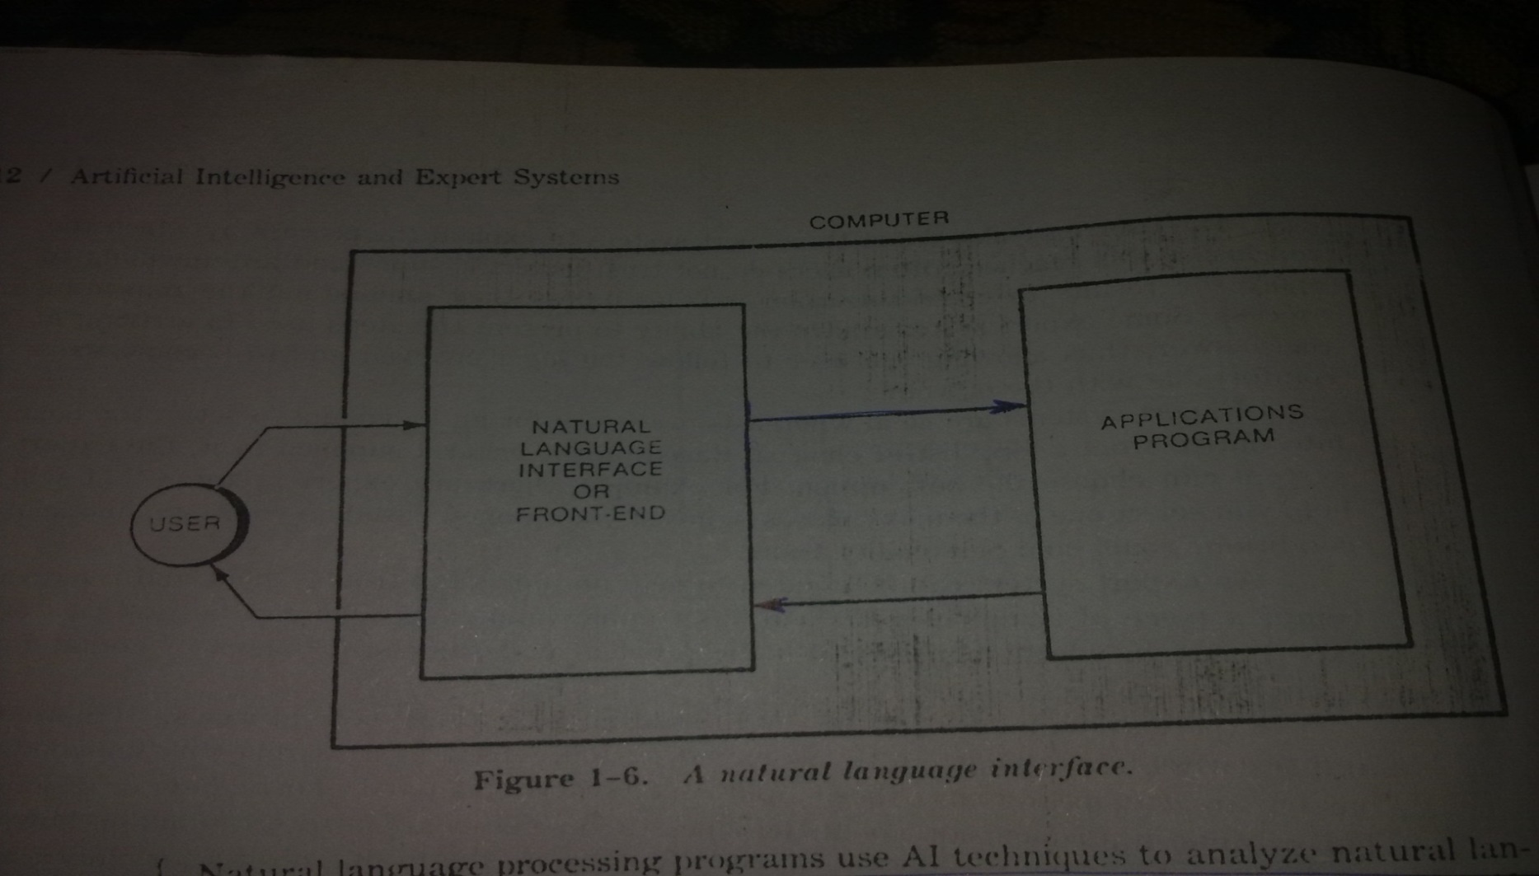
Natural language Interface
A natural language interface allows the user to interact with computer in their every day or natural language.
A application program is any program designed to perform a specific function directly for the user. Examples of application programs Web browsers , image editing programs

Slide 35
Natural language Interface
A user interface that allows people to interact using a human language, such as English, urdu e.t.c,
Also a user interface like command line interface, or graphical user interface.
Natural language interfaces may be designed for understanding either written or spoken text.

Slide 36
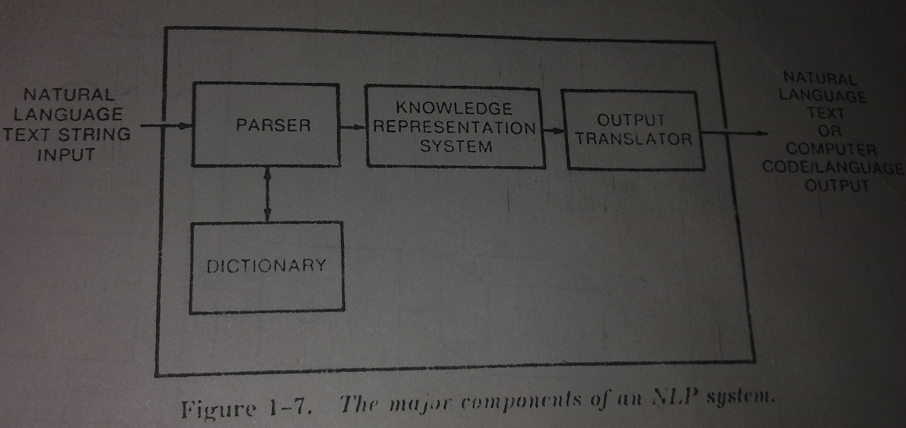
Components of an NLP System
Parser: A parser is a complier component that break data in to smaller elements for easy translation into another language.
Knowledge Representation system: The system dedicated to representing information about the world and can utilize to solve complex task. Or it also define knowledge representation language(formal language), with clearly defined syntax and semantics.

Slide 37
Examples of Natural Language Processing
Optical Character Recognition: Converting scanned images to readable text or data. (editing).(bar codes)
Speech Recognition: Converting spoken words into data.
Machine Learning: Using natural language to train artificial intelligence.

Slide 38
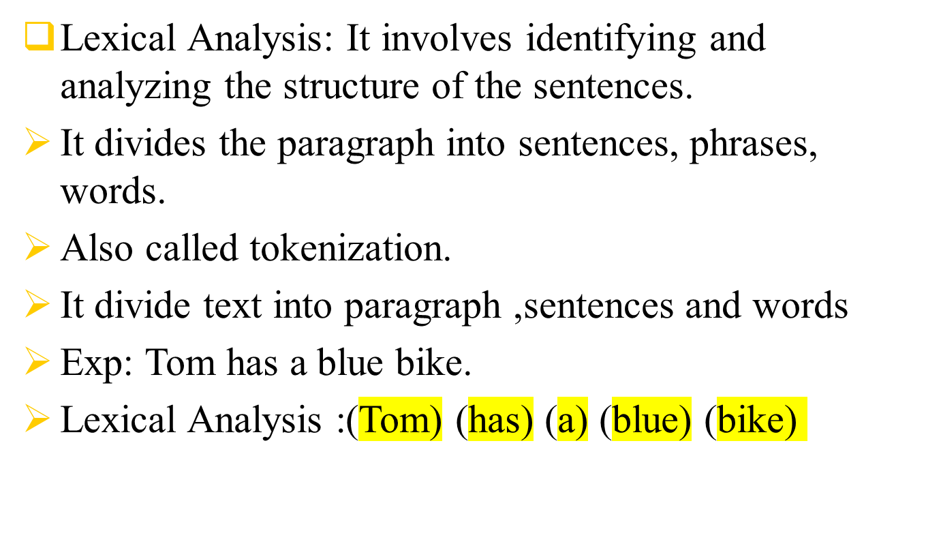
Steps Involved in NLP

Slide 39
Steps Involved in NLP
Syntactical Analysis or (Parsing):
It also called parsing.
It check the grammar.
Here the sentences are parsed as a noun, adverb, adjective and other part of sentences.
Exp: The cat sat on the table.
The(article) cat(noun) sat(verb) on(preposition)
the(article) table(noun).
So we understand the structure of sentences in Syntactical Analysis.

Slide 40
Note:
If the structure of sentences is known then need to find out its meaning.

Slide 41
Steps Involved in NLP……
Semantic Analysis: Here the actual meaning of the sentence is derive from the words used.
The semantic analysis checks weather the sentences makes any meaning.
Example: Bitter sugar or “hot ice-cream”
This is rejected in sematic phase because its does not makes any meaning but its grammar is correct.
If the meaning of sentences had made so then Disclosure integration come.

Slide 42
Steps Involved in NLP……
Disclosure integration: Here the meaning of the sentence is verified with sentence before it.
or
The meaning of any sentence depends upon the meaning of the sentence just before it.
Example : Ahmad had a black pen.
Ali wanted it.
Some time student not understand the teacher because he not attend the first class.

Slide 43
Steps Involved in NLP……
Pragmatic Analysis:
It is concerned with practical matters.
In Pragmatic Analysis the sentence are re-interpreted (or) re-translate to verify the correctness of the meaning in the given context.
Here the real world knowledge of language is required or displayed.
It involves deriving those aspects of language which require real world knowledge. Computer will check that did I can speak.
E.g: Banana is a fruit.
Birds can fly.

